Slide 1

CSE-5335: Presentation
GrowthLink – Academic Networking Platform
Team Members: Group 7
Mehak Malhotra
Kudithipoodi Dillip
Kota Keerthana
Kotha Raghavendra Reddy
Mekala Raga Shreya
Section: 5335-005
FALL 2024

Slide 2

PHASE 4 Demo

Slide 3
Primary Objective
Main Goal:
"To create an integrated academic platform that connects students with mentors, resources, and opportunities in real-time”
Core Objectives:
Facilitate Mentorship Connections
Streamline Academic Event Management
Enable Real-time Professional Networking
Provide Career Development Resources

Slide 4
Problems We Solve
Current Challenges:
1. Mentorship Gap
Difficulty finding relevant mentors
Limited access to industry professionals
Unstructured mentorship processes
2. Event Management Issues
Scattered event information
Complex registration processes
Poor attendance tracking
3. Communication Barriers
Delayed responses
Fragmented communication channels
Limited networking opportunities

Slide 5
Our Solution
Integrated Features:
1. Structured Mentorship Program
Mentor-mentee matching
2. Centralized Event Platform
Easy registration
Calendar integration
3. Real-time Communication
Instant messaging

Slide 6
Tech Stack
Frontend
Next.js 14 (React Framework)
TailwindCSS & Shadcn/ui(UI components)
Backend
PHP WebSocket Server
RESTful APIs
JWT Authentication
Database
MySQL Database
Prisma ORM
Architecture delivers scalable, real-time features with secure data management using modern development standards.

Slide 7
Team Members Contribution
Member 1: Frontend Architecture
Dashboard implementation
Navigation system
Responsive design
Member 2: Authentication & User Management
Multi-role authentication
User profile management
Access control
Member 3: Real-time Features
Chat system
WebSocket server
Notification system
Member 4: Event Management System
Event creation
Registration system
Calendar integration
Member 5: Career Development & Resources
Career resources module
Mentorship program
Professional tools

Slide 8
Benefits
Users (Students)
Access to industry mentors and personalized guidance
Easy registration for academic events and workshops
Career resources and professional development tools
Real-time networking opportunities
Organizers
Streamlined event creation and management
Session scheduling system
Employers
Direct access to qualified candidates
Job and internship posting capabilities
Real-time communication with potential hires
Mentors
Efficient mentee management system
Professional profile showcase

Slide 9
Challenges Faced
Technical Hurdles & Solutions
Real-time Chat Implementation
Challenge: WebSocket integration with MySQL
Solution: Custom PHP WebSocket server with message queuing
Role-based Navigation
Challenge: Dynamic menu based on user roles
Solution: Implemented filtered navigation system
Event Management
Challenge: Complex event registration system
Solution: Integrated calendar with real-time updates

Slide 10
Creative Functionalities
Innovative Features
Career Development Tools
Resume Writing Tips
Interview Preparation
Professional Development
Career Assessment Tools
Mentorship System
Application tracking
Mentor-mentee matching
Academic Events Platform
Event type filtering
Calendar integration
Session management

Slide 11
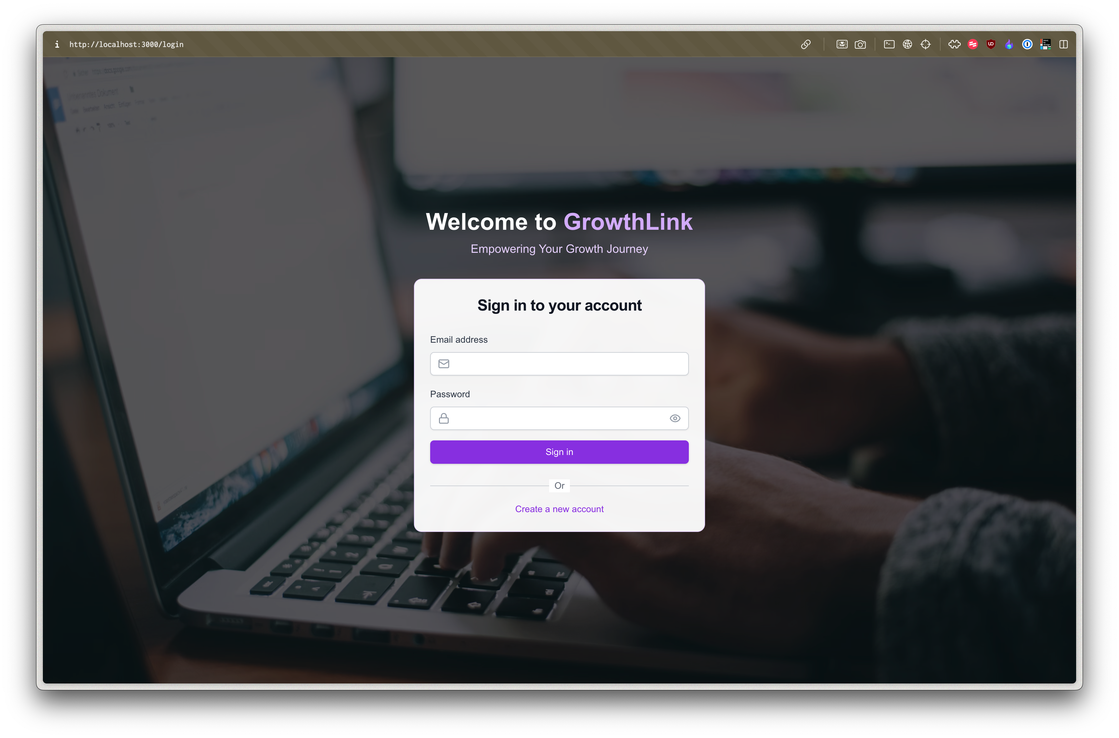
Login Screen

Slide 12
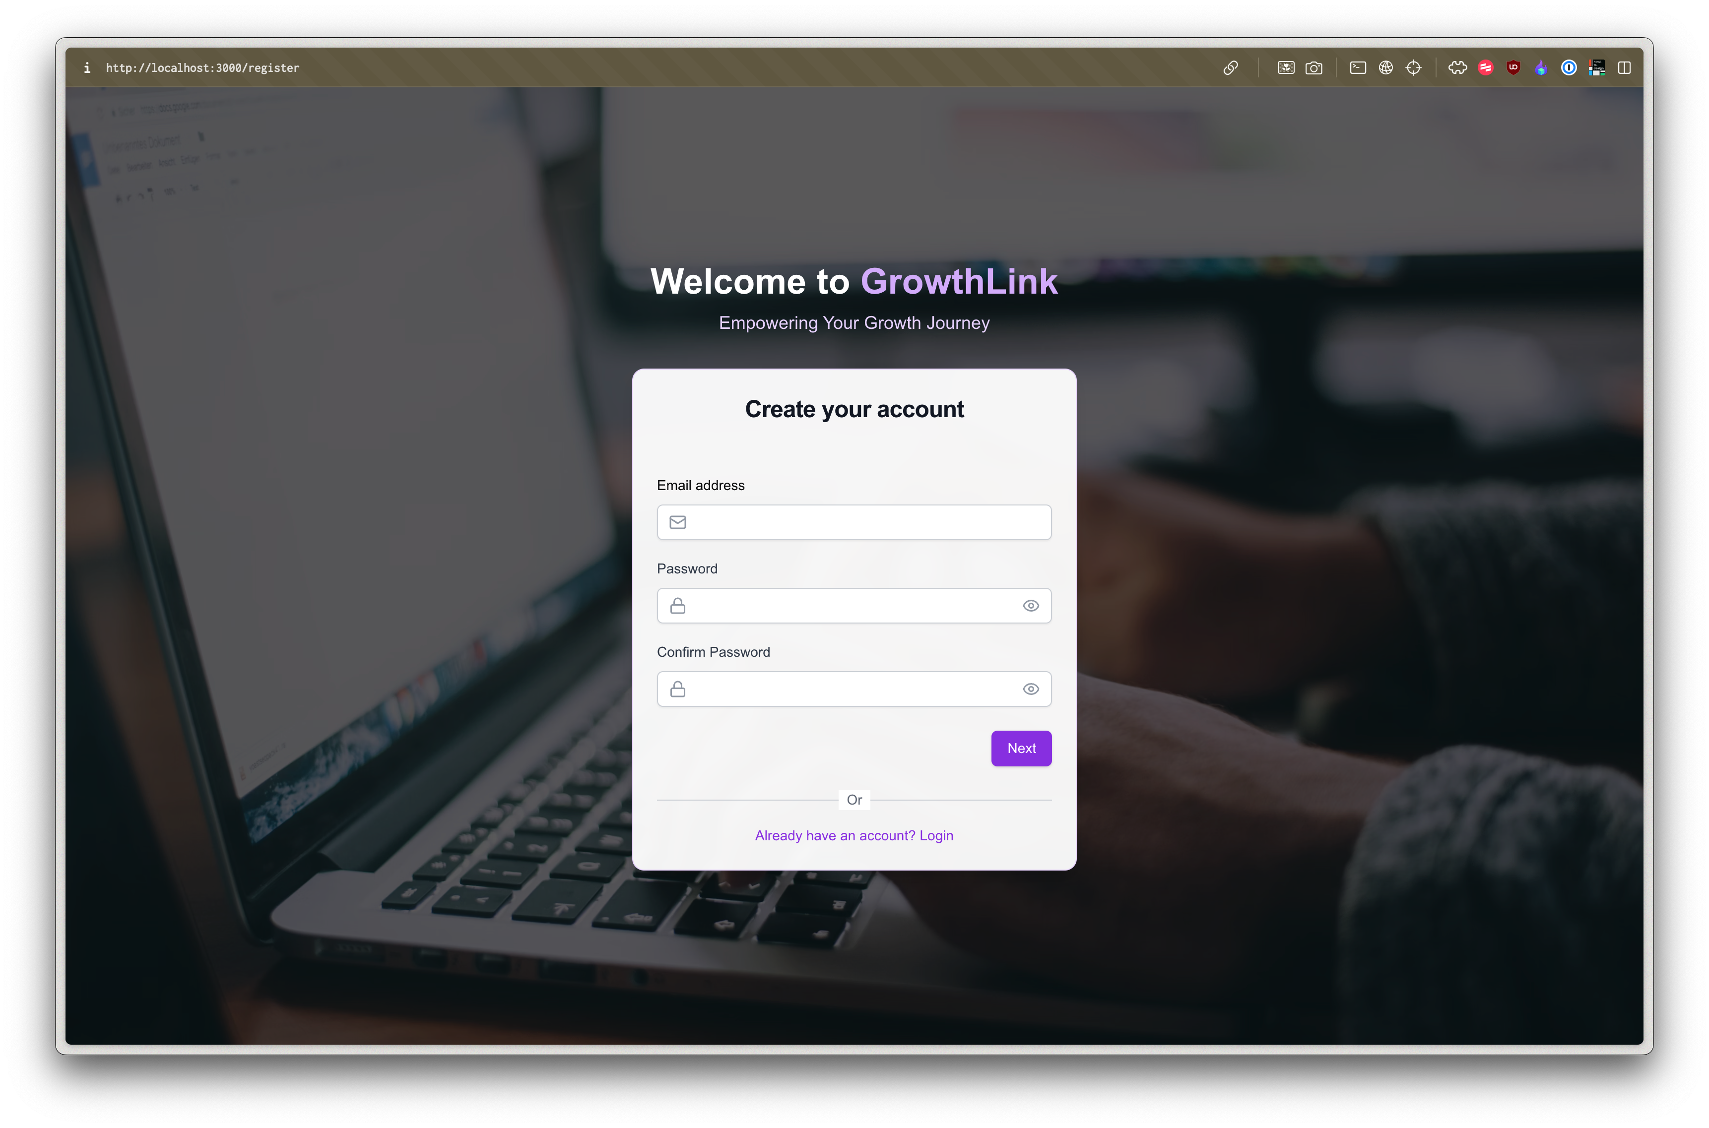
Register Screen

Slide 13
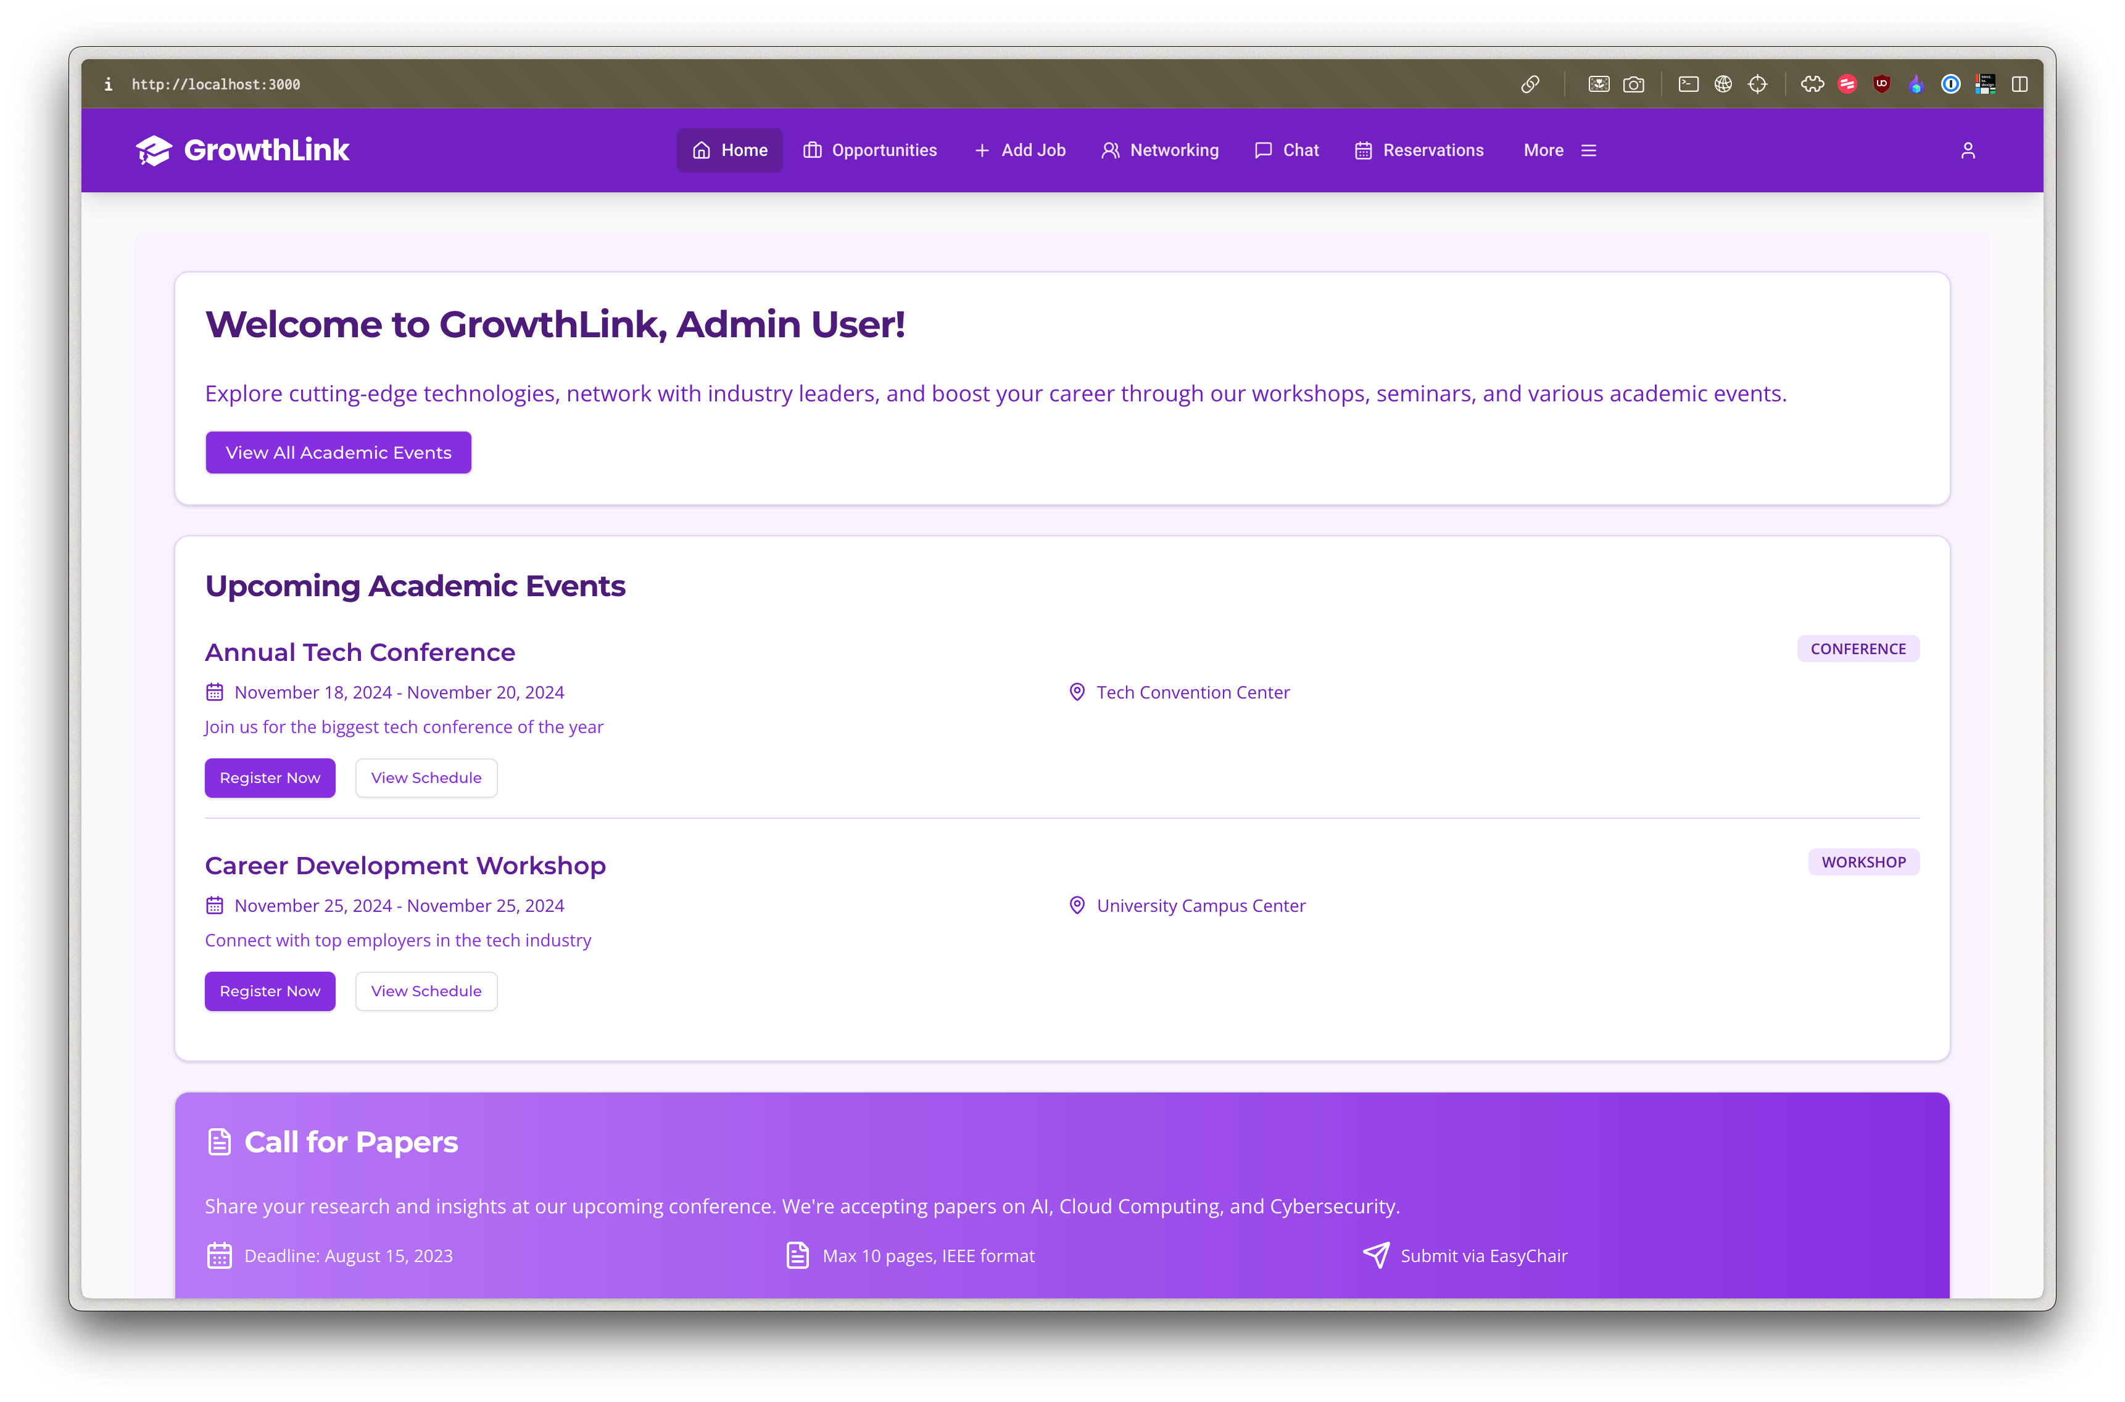
Admin Dashboard

Slide 14
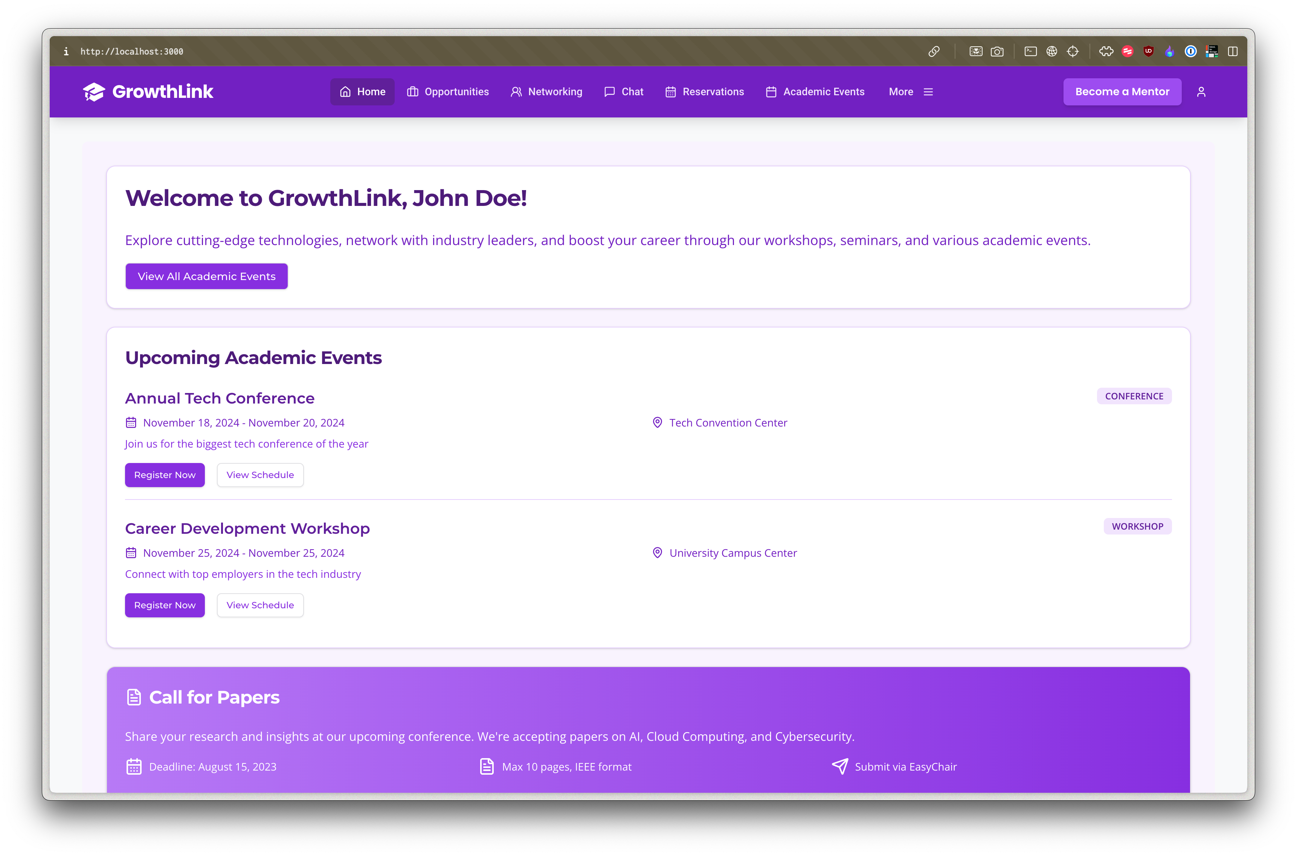
User Dashboard

Slide 15

Organizer Dashboard

Slide 16

Thank You

